Slide 1
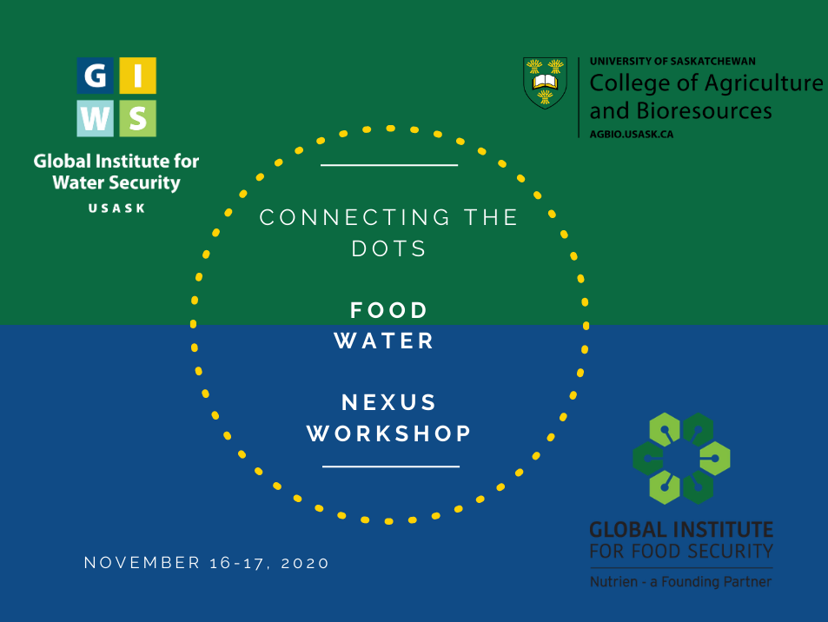

Slide 2
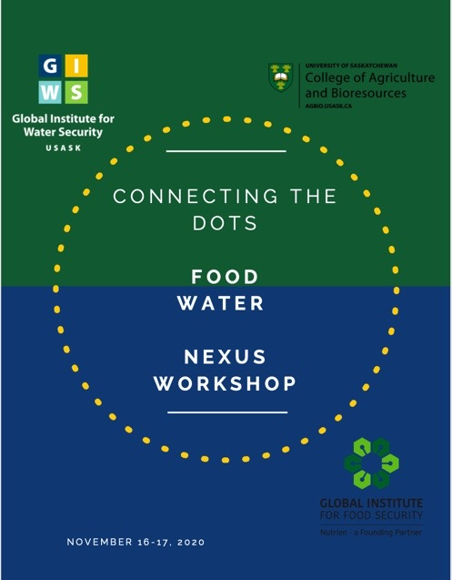
Logistics
Please join session 5 minutes in advance
Keep talks to 5 minutes
Stay on mute unless speaking or asking a question
Send questions to host Palash Sanyal (or raise hand)
Use time between sessions make connections and have further discussions
Last session of both days is for open discussion, big ideas, brainstorming, etc.
All sessions recorded and posted
Zoom links: one link for M-T at 9; one for M-T at 11, etc.

Slide 3
Goals
Survey the landscape of food-water research on campus and get to know each other
Catalyze new collaborations; reveal and expand ongoing collaborations; build synergies on campus
Identify topics for deeper-dive discussions and workshops
Begin thinking about new projects, proposals, facilities, faculty, and programs
Identify areas where USask is uniquely positioned to lead

Slide 4
Outcomes
Report to campus administration and unit leaders on strengths and opportunities
Follow-up workshops - hopefully this is the first of many that will result in:
Joint research, papers and proposals
Ideas for new faculty hires, strategic chairs and new programs
First steps towards national and international leadership on food-water nexus

Slide 5
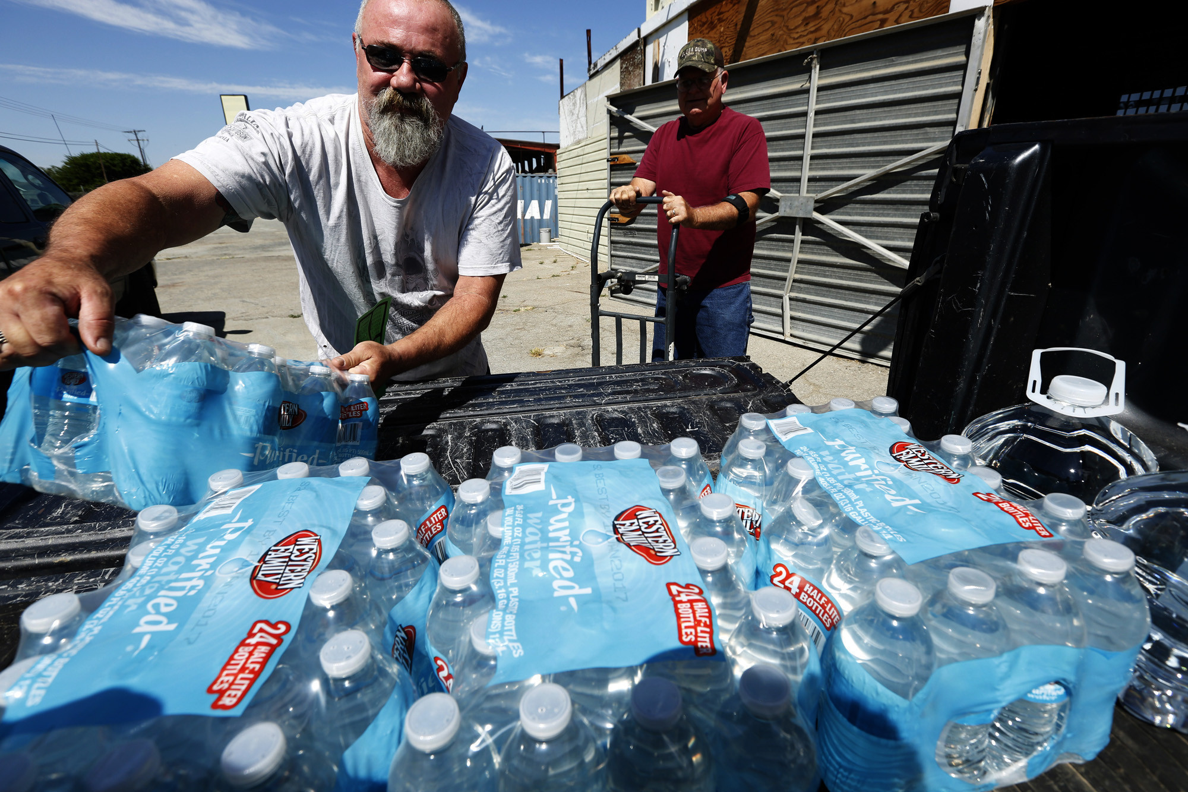

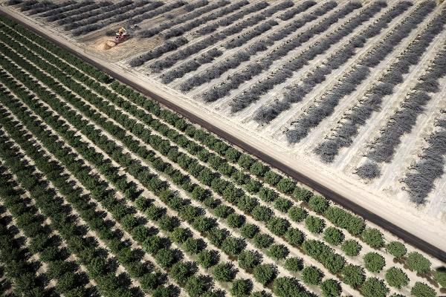
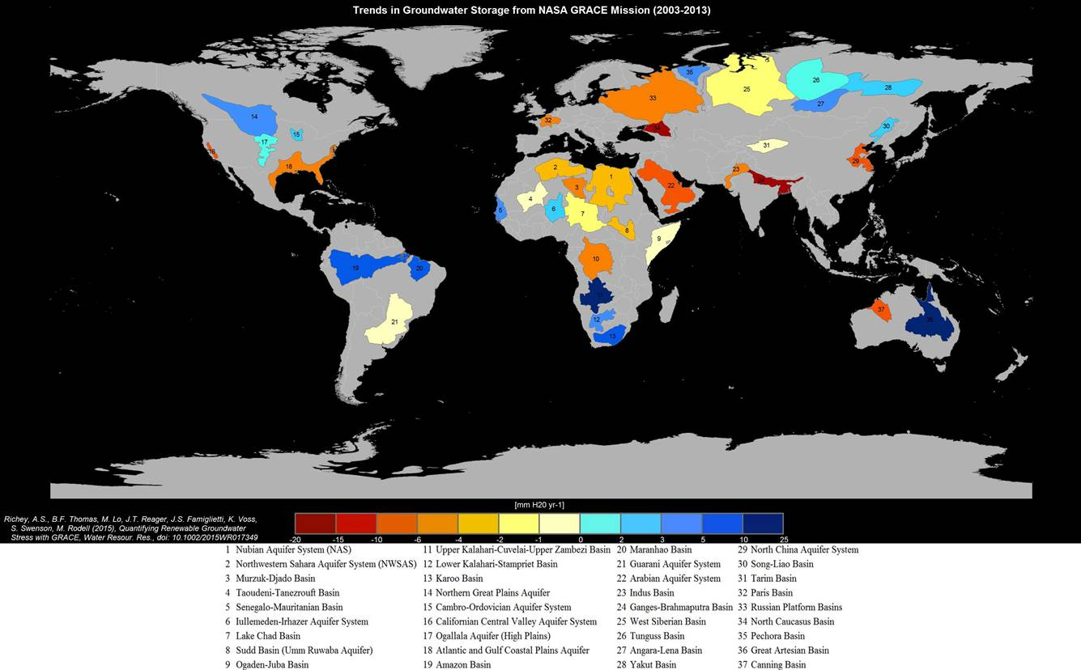
Who am I?
Hydrologist who develops computer models and new satellite methods for tracking how freshwater availability is changing around the world.
Science communicator, to government and to general public, especially on water insecurity and how it will drive food insecurity
Notes:
Most are in a state of chronic water scarcity
This persistent state is exacerbated and exposed by drought
It is primarily due to exceptional water needs of the food industry
It is important for the public to grasp this state of affairs because in constrast to drought, there is no end in sight
There are many ‘solutions’ for our metropolitan regions but fewer for agriculture. It simply uses too much water.
Agricultural conservation, efficiency, water pricing and innovation are the key for now.
Either we move water to the food producing regions like the Central Valley or the southern High Plains of the US, or we move agriculture out over time.
We have new groundwater legislation in California, but it is going to take another 25 years to implement.
Food production due to water scarcity is going to be a major, global problem that needs our immediate attention
In the US, given that the southern High Plains and the Central Valley grow food for the nation, it may be time to recognize these regional water problems as national problems.

Slide 6
What have I done?
Improving the hydrologic components of land surface models in climate models
Space-time variability in surface soil moisture from a remote sensing perspective
Pioneered hydrologic applications of the NASA GRACE satellite mission, especially how to measure and monitor groundwater storage changes from space
Notes:
Most are in a state of chronic water scarcity
This persistent state is exacerbated and exposed by drought
It is primarily due to exceptional water needs of the food industry
It is important for the public to grasp this state of affairs because in constrast to drought, there is no end in sight
There are many ‘solutions’ for our metropolitan regions but fewer for agriculture. It simply uses too much water.
Agricultural conservation, efficiency, water pricing and innovation are the key for now.
Either we move water to the food producing regions like the Central Valley or the southern High Plains of the US, or we move agriculture out over time.
We have new groundwater legislation in California, but it is going to take another 25 years to implement.
Food production due to water scarcity is going to be a major, global problem that needs our immediate attention
In the US, given that the southern High Plains and the Central Valley grow food for the nation, it may be time to recognize these regional water problems as national problems.

Slide 7
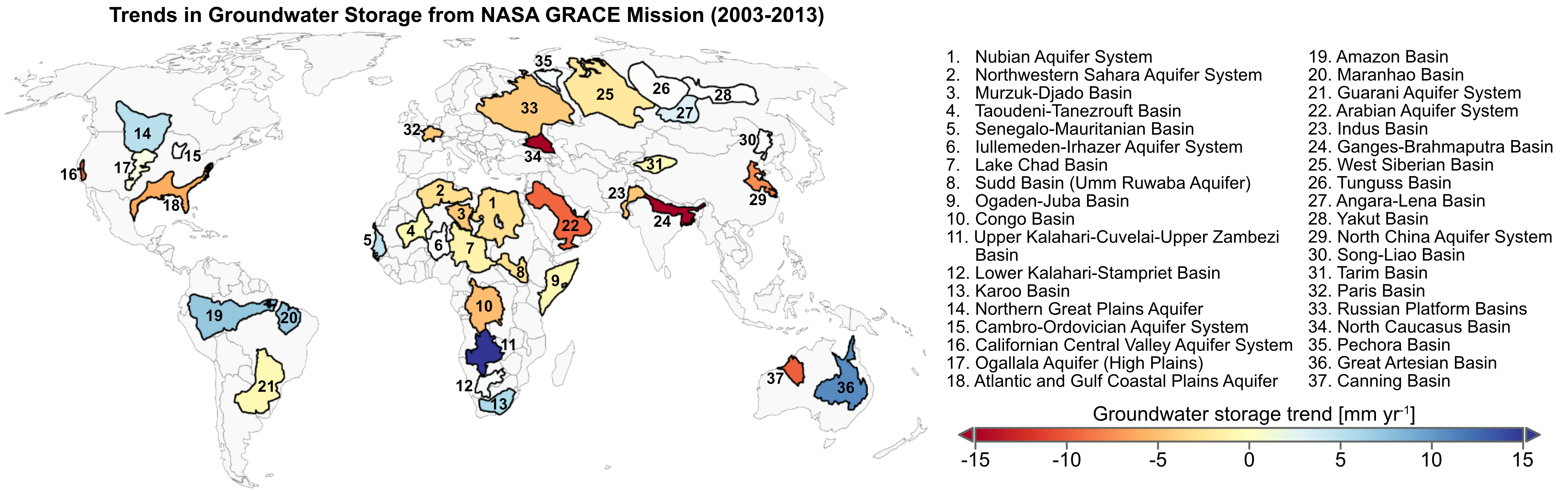

Aquifer depletion rates from GRACE (2003-2013)
Richey et al., 2015, Water Resources Research

Slide 8
What am I doing?
Taking action on the last slide in science, policy and communication
Trying to catalyze food-water research on this campus
Wrote CFI for root-zone soil moisture remote sensing facility, ongoing soil moisture remote sensing research
Wrote NFRF on global groundwater sustainability, ongoing work on prairie groundwater sustainability, global groundwater sustainability and groundwater-dependent food production
Exploring financial levers on the food industry to drive water sustainability
Notes:
Most are in a state of chronic water scarcity
This persistent state is exacerbated and exposed by drought
It is primarily due to exceptional water needs of the food industry
It is important for the public to grasp this state of affairs because in constrast to drought, there is no end in sight
There are many ‘solutions’ for our metropolitan regions but fewer for agriculture. It simply uses too much water.
Agricultural conservation, efficiency, water pricing and innovation are the key for now.
Either we move water to the food producing regions like the Central Valley or the southern High Plains of the US, or we move agriculture out over time.
We have new groundwater legislation in California, but it is going to take another 25 years to implement.
Food production due to water scarcity is going to be a major, global problem that needs our immediate attention
In the US, given that the southern High Plains and the Central Valley grow food for the nation, it may be time to recognize these regional water problems as national problems.

Slide 9
What woud I like to see?
A major interdisciplinary effort in agro-hydrological modeling
A major interdisciplinary effort in digital agro-hydrology including remote sensing across scales
More detailed research at the plant-water interface in the root zone
New, interdisciplinary water-food-policy research
More cross-campus initiatives like GIFS’ Bangladesh initiation
More Usask-led reports and studies of important food-water topics, like GIWS’ preliminary assessment of the Saskatchewan irrigation project
Very strong Usask scientific leadership on these topics, including science communication and policy advising
A world-leading food-water program at USask
Notes:
Most are in a state of chronic water scarcity
This persistent state is exacerbated and exposed by drought
It is primarily due to exceptional water needs of the food industry
It is important for the public to grasp this state of affairs because in constrast to drought, there is no end in sight
There are many ‘solutions’ for our metropolitan regions but fewer for agriculture. It simply uses too much water.
Agricultural conservation, efficiency, water pricing and innovation are the key for now.
Either we move water to the food producing regions like the Central Valley or the southern High Plains of the US, or we move agriculture out over time.
We have new groundwater legislation in California, but it is going to take another 25 years to implement.
Food production due to water scarcity is going to be a major, global problem that needs our immediate attention
In the US, given that the southern High Plains and the Central Valley grow food for the nation, it may be time to recognize these regional water problems as national problems.

Slide 10

Notes:
Most are in a state of chronic water scarcity
This persistent state is exacerbated and exposed by drought
It is primarily due to exceptional water needs of the food industry
It is important for the public to grasp this state of affairs because in constrast to drought, there is no end in sight
There are many ‘solutions’ for our metropolitan regions but fewer for agriculture. It simply uses too much water.
Agricultural conservation, efficiency, water pricing and innovation are the key for now.
Either we move water to the food producing regions like the Central Valley or the southern High Plains of the US, or we move agriculture out over time.
We have new groundwater legislation in California, but it is going to take another 25 years to implement.
Food production due to water scarcity is going to be a major, global problem that needs our immediate attention
In the US, given that the southern High Plains and the Central Valley grow food for the nation, it may be time to recognize these regional water problems as national problems.

